Slide 1
Statements and Expression
Week 2
Saranya Chandrukannan

Slide 2
Expression
Expression is any combination of values, variables, and operators.
This means anything that returns a value is an expression.
A = 2 - This is an assignment. It assigns a value to a variable.
A= 2+3 - This is an operation.

Slide 3
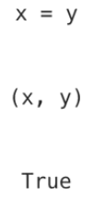
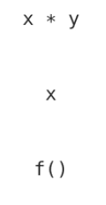
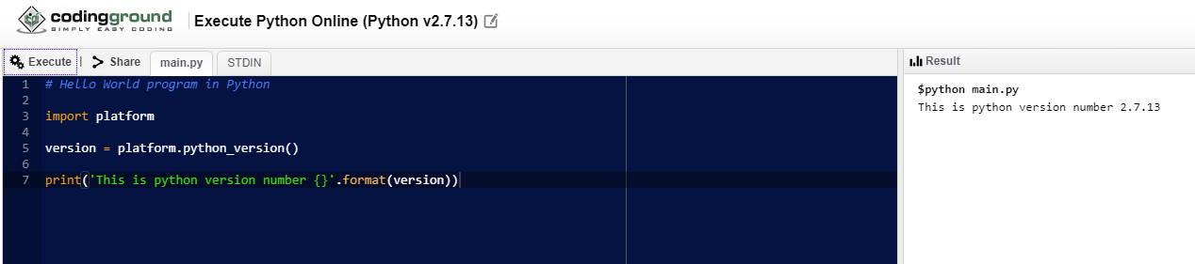
Statements
A statement is a line of code. It may be an expression, may be something like the import statement or a break or a continue.

Slide 4
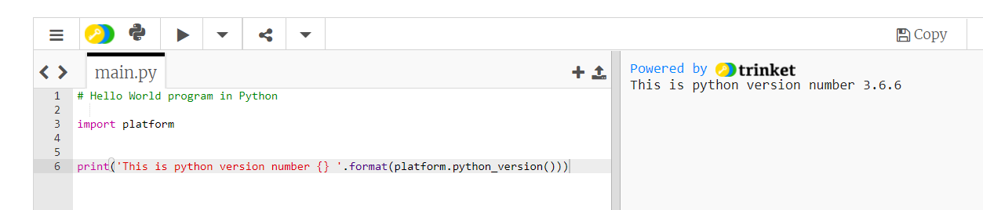

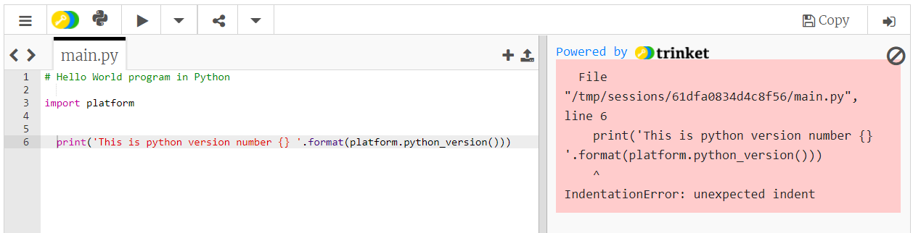

Whitespace(s) - Indentation

Slide 5
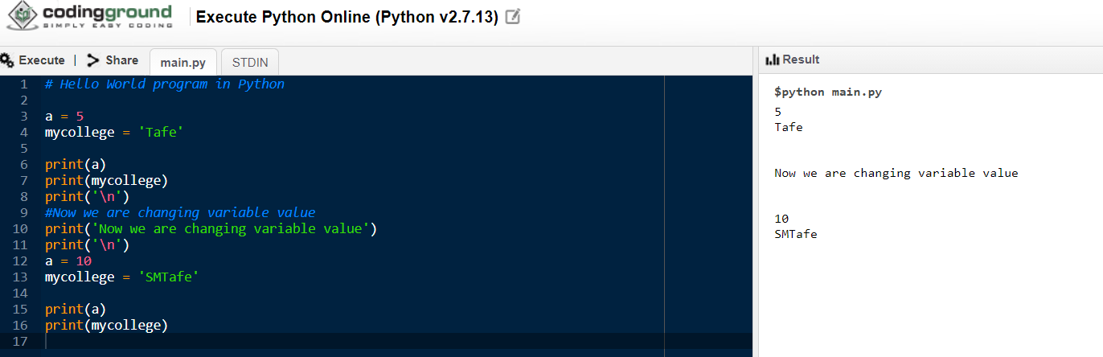
Variable
Variables are used to store information to be referenced and manipulated in a computer program. This value will keep changing depends on your program.

Slide 6
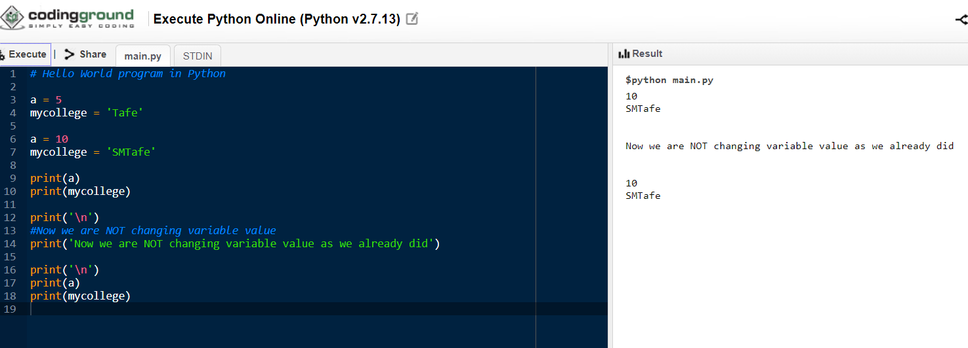
Variable (contd)

Slide 7
Datatype
Variables can store data of different types, and different types can do different things. So Data type is, Type of the data stored.
Text Type: | str
Numeric Types: | int, float, complex
Sequence Types: | list, tuple, range
Mapping Type: | dict
Set Types: | set, frozenset
Boolean Type: | bool
Binary Types: | bytes, bytearray, memoryview

Slide 8
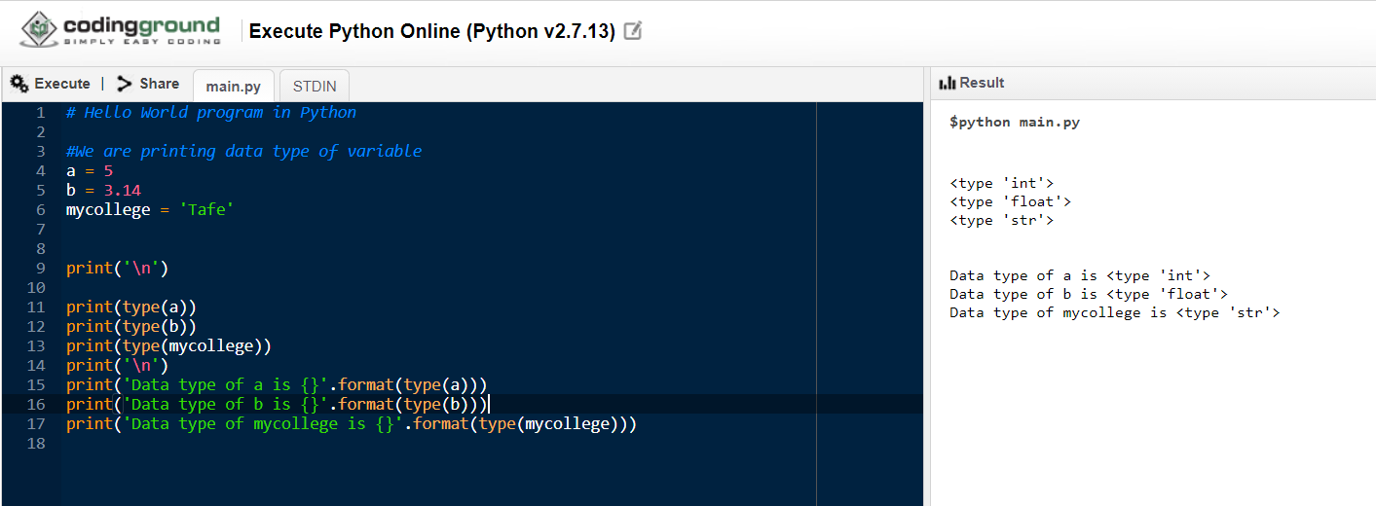
Datatype (contd)
In this example, we will look at the basic data type int, float, string

Slide 9
Operators
Operators perform operation on variables and values.
There are group of operators in Python:
Arithmetic operators
Assignment operators
Comparison operators
Logical operators
Identity operators
Membership operators
Bitwise operators

Slide 10
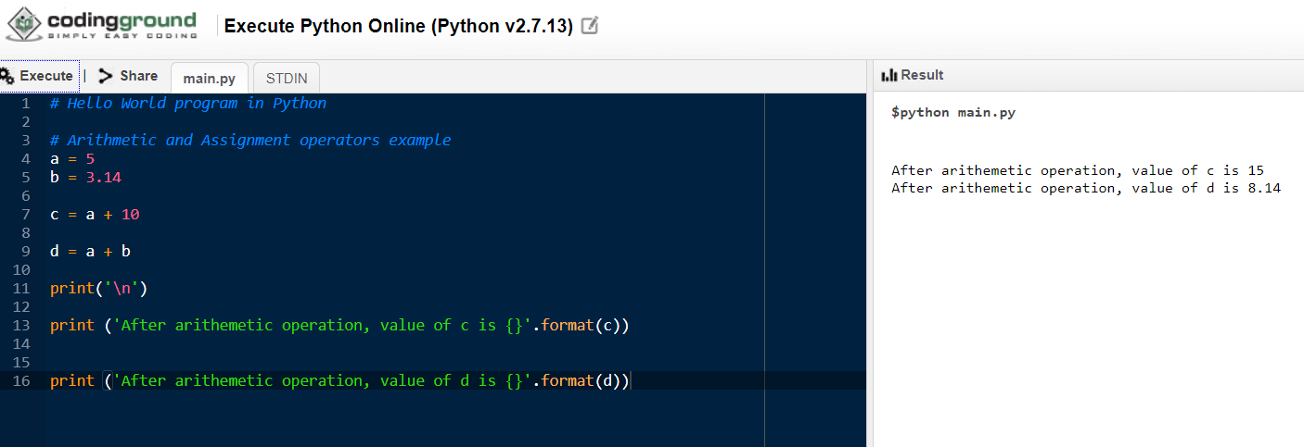
Arithmetic and Assignment

Slide 11
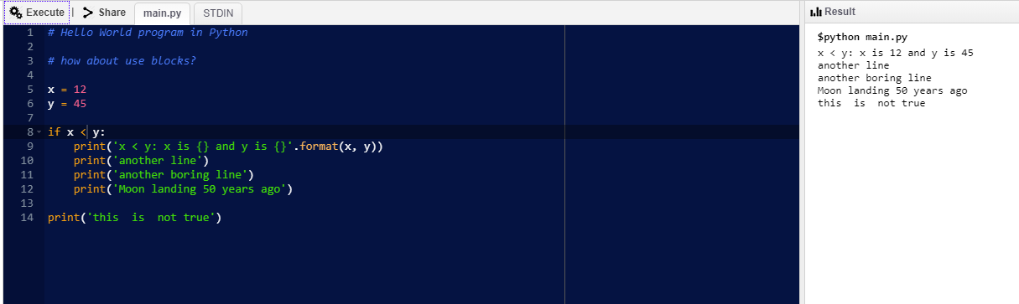
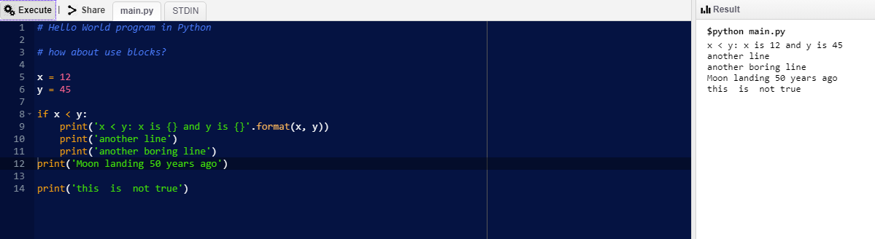
Conditional Operator
If x < y

Slide 12
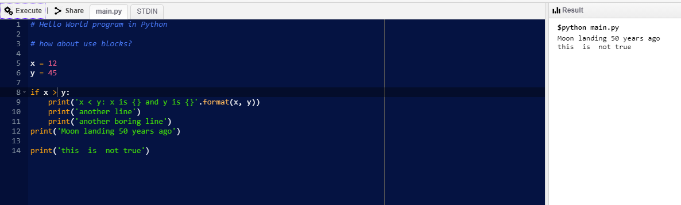
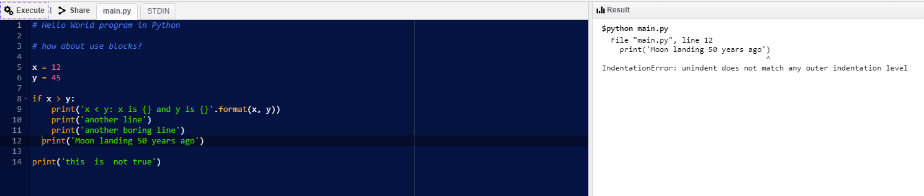
If x > y

Slide 13
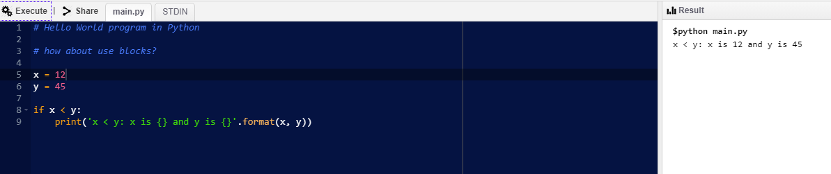
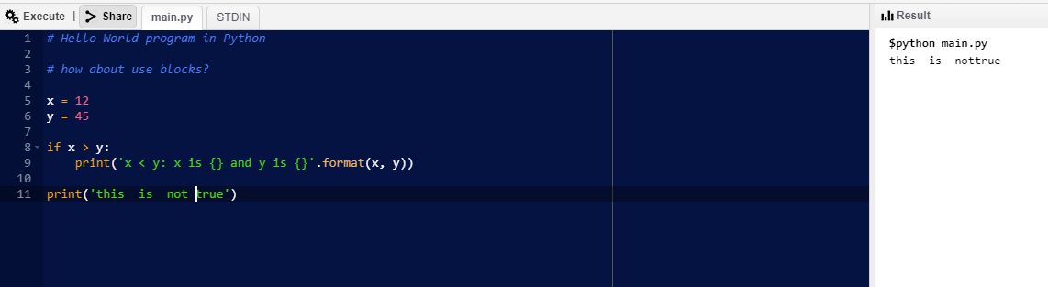
Code Blocks

Slide 14
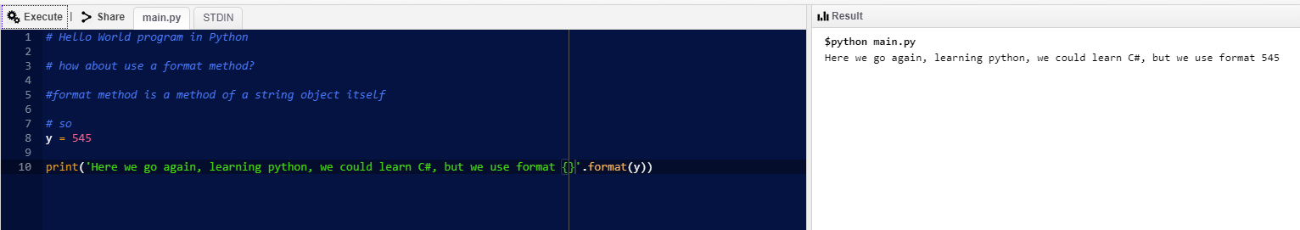

Format function()

Slide 15
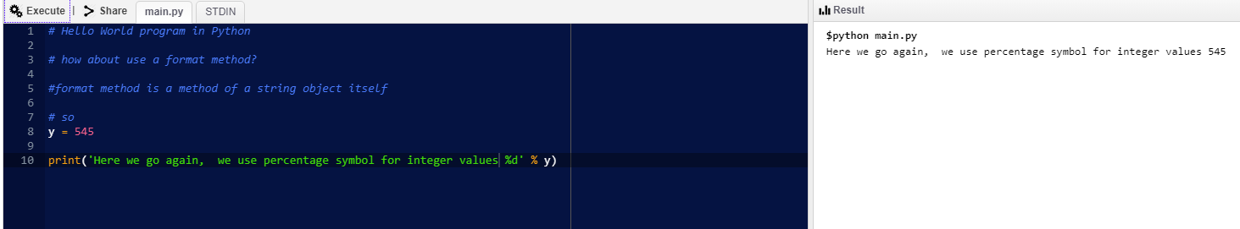
How about integer values?

Slide 16
Python – Quiz and Exercises Week 2
Saranya Chandrukannan

Slide 17
What is the name of the programming language we are learning?
Java
Python
C++
Scala

Slide 18
The number or word we give to a variable is called :
Value
Bug
import
function

Slide 19
What is a variable?
A box(memory location) where you store values
a type of graphics
Data type
a type of memory

Slide 20
What is the word (command) used to display numbers and text on the screen?
input
print
output
command

Slide 21
What symbol is used in python to assign values to a variable?
equals =
plus +
forward slash /
asterisk *

Slide 22
What will be the output? name = 'Dave' print(name)
Dave
'Dave'
name
(name)

Slide 23
What would print(10 + 16) produce?
10 + 16
22
26
Error

Slide 24

Which is the Python logo?

Slide 25
What is a input?
A function that allows us to ask the user to enter some data.
To plug in something.
Data displayed on a screen.

Slide 26
What is a output?
Data that the user enters
A piece of data that is shown on the screen
Code we entered in screen
Arithmetic Operator

Slide 27
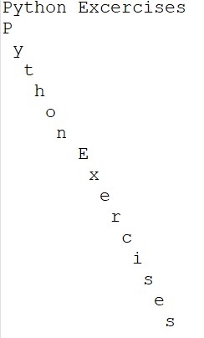
Exercise#1
Write a program to print as below

Slide 28
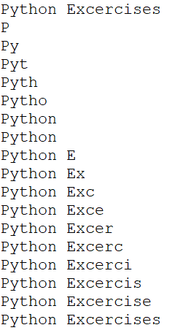
Exercise#2
Write a program to print as below:
Hint (use print(variablename[0:1])

Slide 29
Exercise#3
Assign some number value to the variable called ‘number’
solve this equation in program and print the output
Output should be equal to ((((number +4) / 8 )*2) + 22)
Example:
number = 28
Output should display as 30 [ example - ((((28+4)/8)*2)+22)) ]

Slide 30

Exercise#4 (Same as Ex#3, but try with 35 number and explain the output)
Assign number to 35
solve this equation in program and print the output
Output should be equal to ((((number +4) / 8 )*2) + 22)

Slide 31
Thank you

